Slide 1
DATA SCIENCE class XvI: time series analysis

Slide 2
agenda
Interview question
Exit ticket
Autoregressive models
Moving Average models
ARMA Models

Slide 3
Interview questions
What does a support vector machine do?
What is C in the support vector machine algorithm?
What is a kernel function?
What are Pipelines in sklearn?

Slide 4
Exit ticket questions
When should I use SVM?
When to use Pipelines in the real world?
Example when you used SVM and Pipelines?
Which type of kernel should we use?
Which classifier to try first?

Slide 5
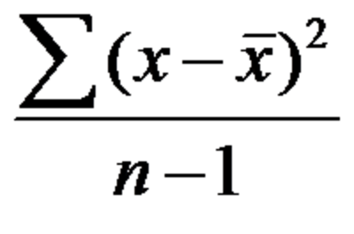
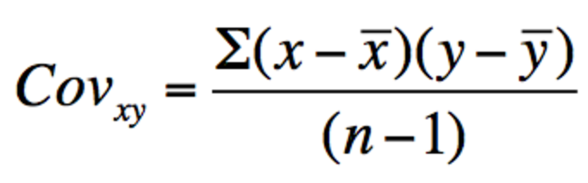
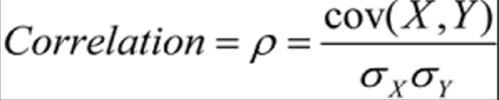
Statistics recap
Variance – Standard deviation squared. It is the average squared distance from the mean.
Covariance – Measure of how much two variables move
together. Can be really negative or positive
Correlation: Goes from -1 to 1, measures the strength of linear relationship
between two random variables

Slide 6
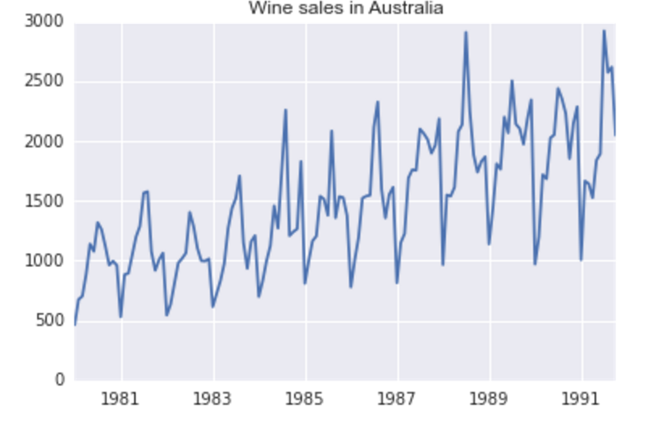
Examples of time series
A time series is a set of observations, x_{t}, each one being recorded at a specific time t.

Slide 7
Examples of time series
May be many objectives for fitting time series models:
Useful to provide a compact description of the data
Separation of noise from filtering
Predicting future values
Testing hypothesis
Predicting one series from another

Slide 8
Examples of time series
Just like data for all of our other models, we have to make assumption about our data. Namely, time series data is unpredictable, i.e. there is randomness.
Our goal is to come up with a model that describes our data in a realistic way.

Slide 9
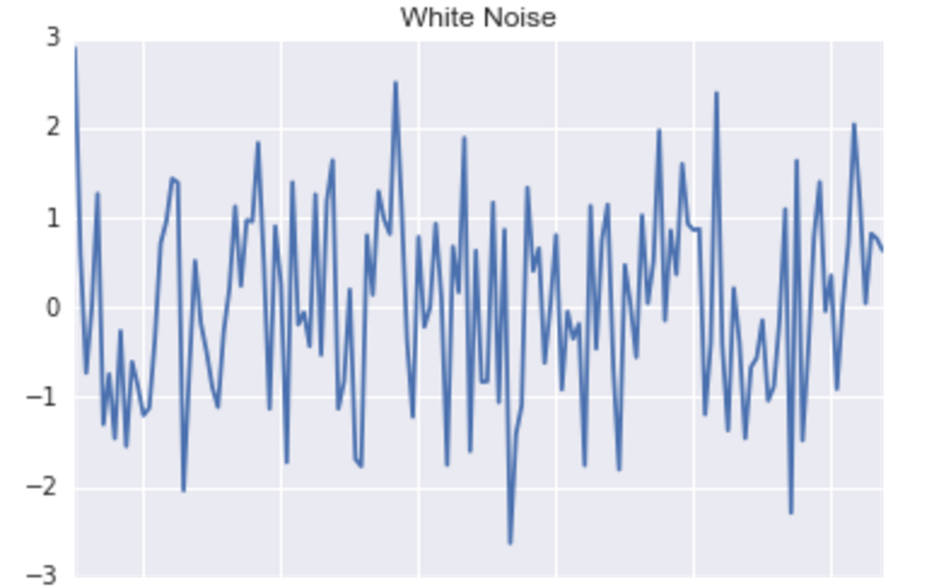
Time series models
White noise – The most basic model. It assumes that there is no trend, or seasonal component. Each observation is randomly distributed with a mean of 0.

Slide 10
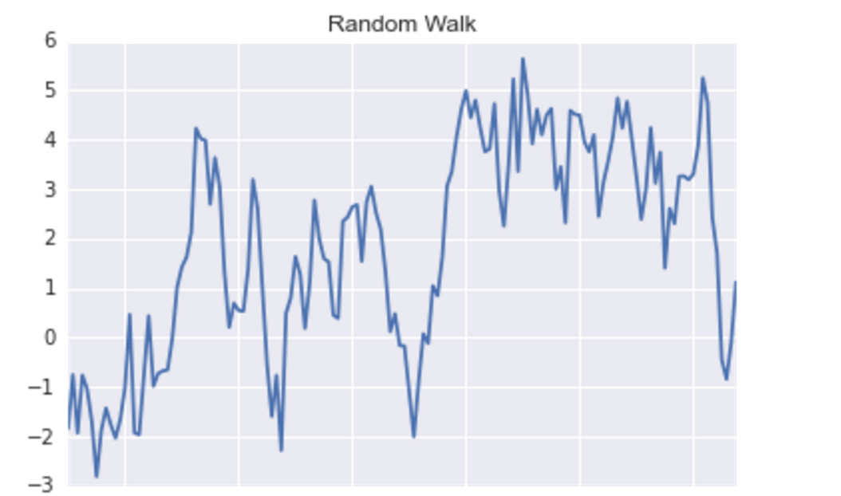
Time series models
Random Walk – This is where you sum up random variables with mean 0. So let’s say you generate these random numbers: -3, 4, 2, 5, 3. Then the series will be
-3, 1, 3, 8, 11 (summing up the numbers in a row).

Slide 11
Time series models
Models with trend and seasonality – most models have trends in them. Below we can see clear seasonal component, as well as a trend. We want to somehow try to fit that data to a model.

Slide 12
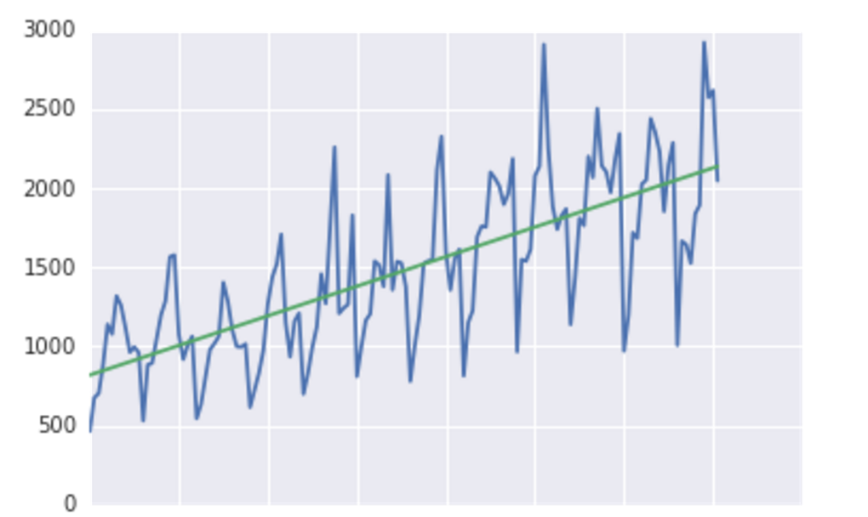
Time series models
First thing we can try to do is fit a linear model to the data:

Slide 13
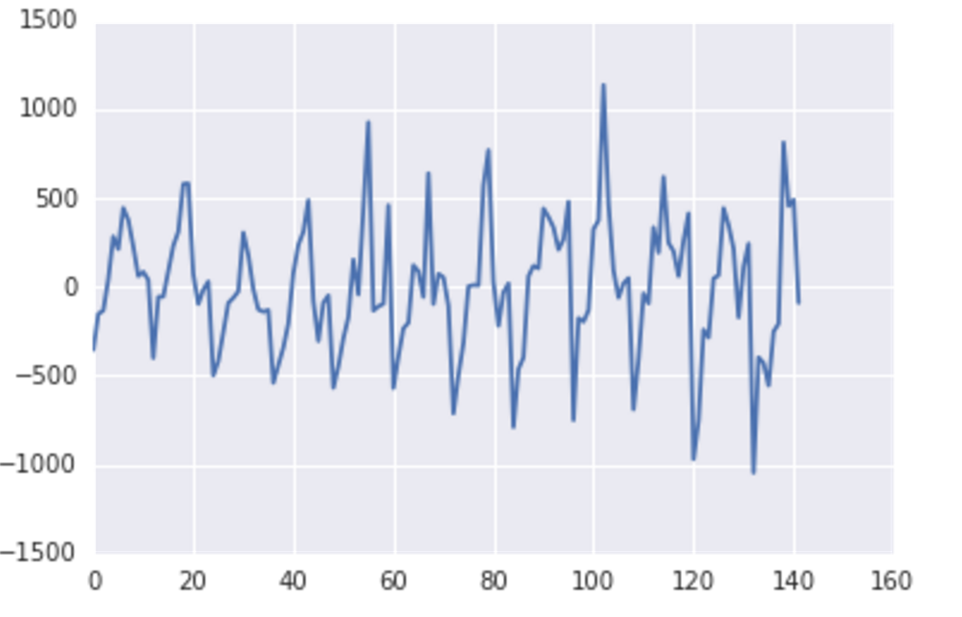
Time series models
First thing we can try to do is fit a linear model to the data:
And then look at the residuals

Slide 14
Time series models
The residuals seem to have a pattern to them. My guess is the next residual will be negative. Can we use this dependence to help us improve our prediction for the next data point?

Slide 15
Time series models
General steps in Time Series Analysis:
Plot the series and examine main features of the graph, in particular:
If there is a trend
Seasonal component
Any apparent sharp changes in behavior
Any outlying observations
Remove the trend and seasonal components to get stationary residuals (residuals that are homoscedastic)
Choose a model that fits the residuals
Forecast residuals forwards and then invert to get forecasted series

Slide 16
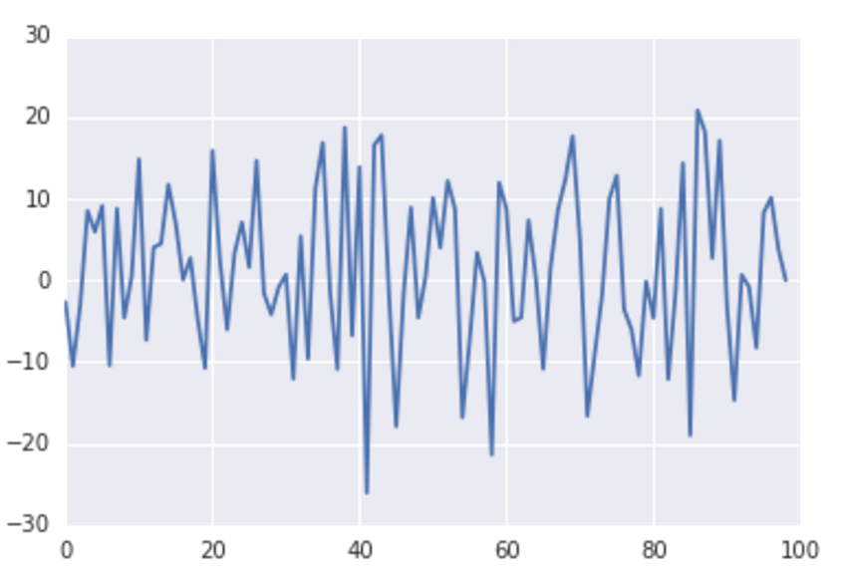
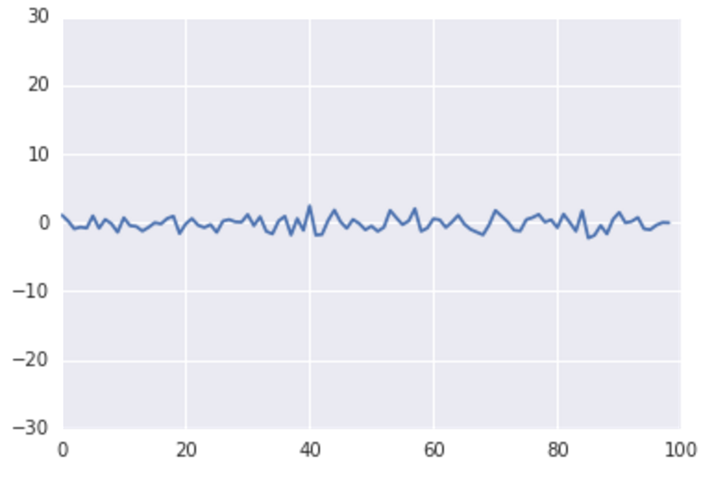
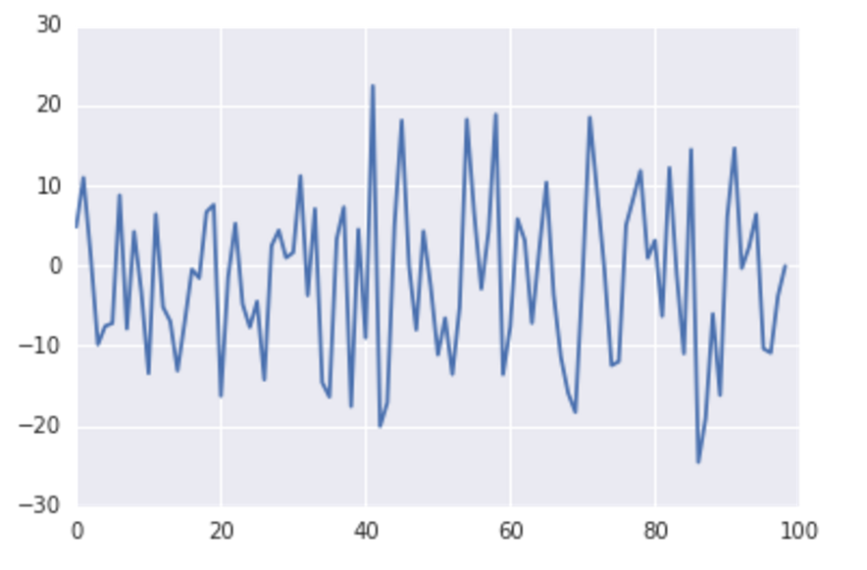
Moving average (ma) process
Different models make different assumptions about how the data is created (white noise, random walk, etc).
Moving Average model: X_{t} = Z_{t} + θZ_{t-1}
What it might look like with =-10,0,10

Slide 17
Moving average (ma) process
What properties to MA processes have that makes them MA?
Like White Noise, their means are still 0
Unlike White Noise, there is correlation between a value, and the one before it. (Obviously, since we generated using data from the last value!) But no correlation with the datapoint two back.

Slide 18
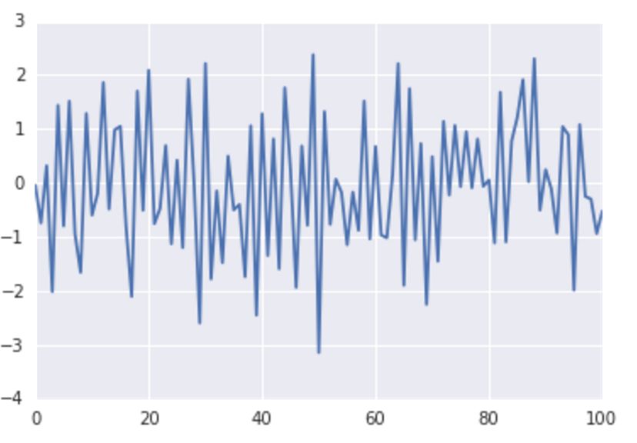
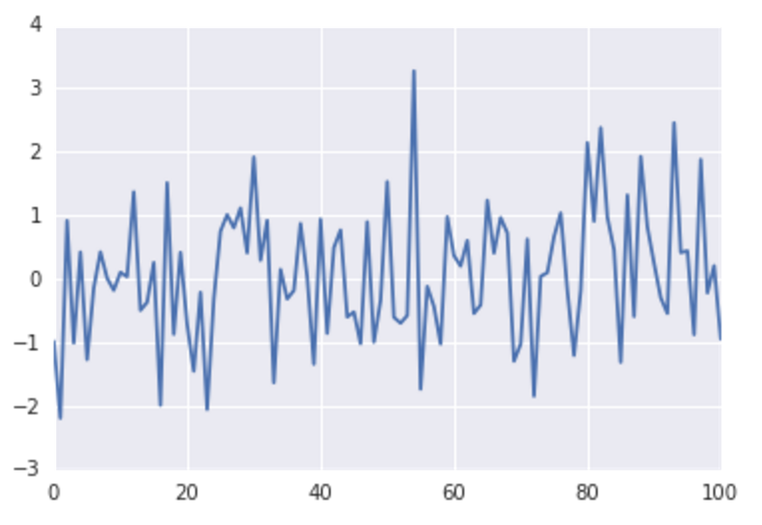
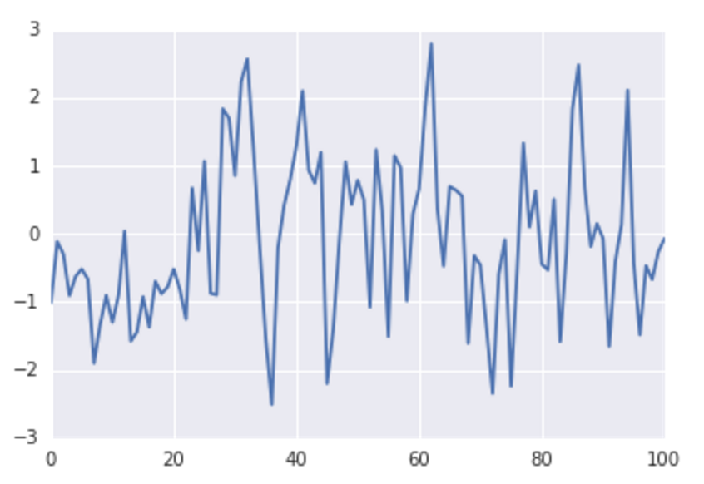
Autoregression or ar(1) process
MA models relied upon a correlation with the previous random term. Autoregressive models rely upon correlation with the previous datapoint.
X_{t} = ΦX_{t-1} + Z_{t}

Slide 19
Autoregression or ar(1) process
AR(1) models visually don’t look much different from what noise. How would you ever know that the data fits an AR process over an MA over white noise?
Difference between AR and white noise is that there is correlation between each point and the previous. There is also correlation between each point and the point 2 back, and on and on.

Slide 20
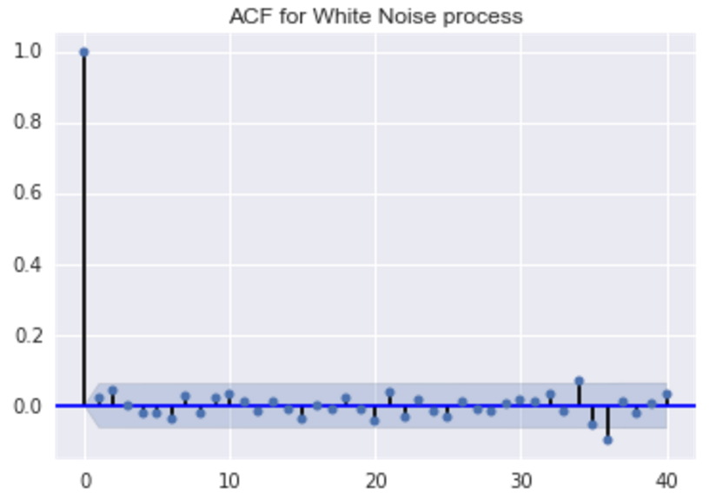
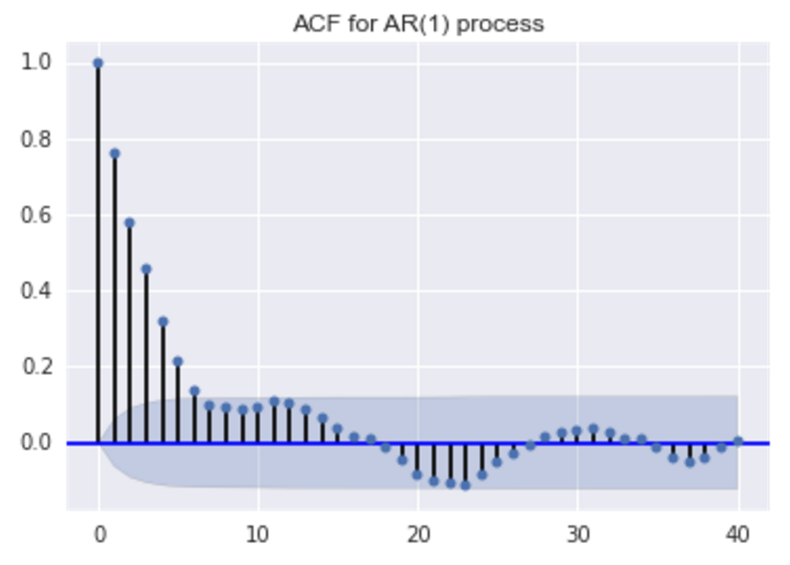
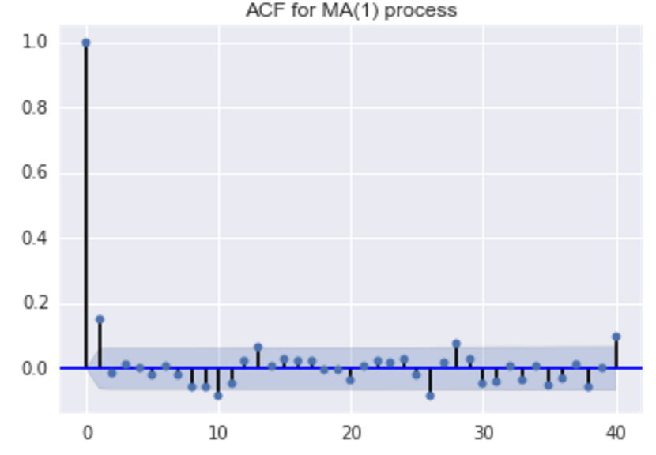
Autocorrelation function
The autocorrelation function (ACF) – calculates the correlation with one point and the one before it, and then the one 2 points back, and on.
Plotting helps determine what the process of the data is.

Slide 21
Autocorrelation function
Plotting the data may reveal interesting things about the data. Namely:
Trend component
Seasonal component
The classical decomposition breaks the time series up into this process, and assumes stationary:
X_{t} = m_{t} + s_{t} + Y_{t}
m – trend, s – seasonal component, Y – random noise

Slide 22
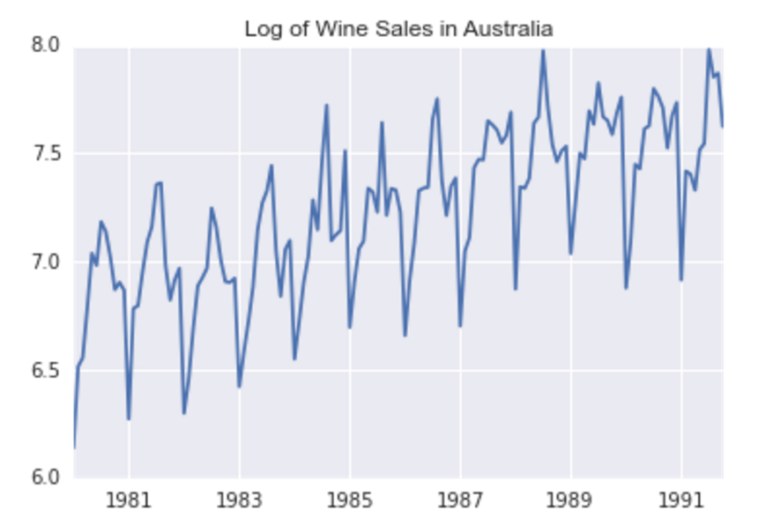
Autocorrelation function
If the seasonal component and trend fluctuations increase over time, you should transform the data. This is because the models expect the time series to be stationary.
Common transformation: Just take the log!

Slide 23
Autocorrelation function
Now that our data is stationary, our goal is to:
Remove the seasonal component
Remove the trend
Fit a model to the residuals
Predict!
So how do we do this amazing stuff?

Slide 24
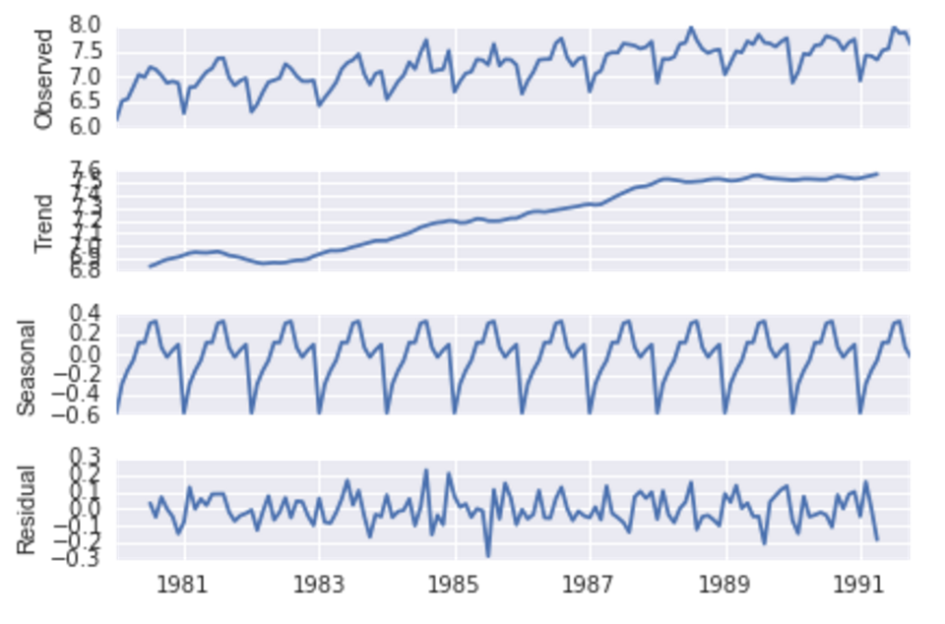
Autocorrelation function
Using statsmodel, we can decompose a
time series into its trend and seasonal
component, and then subtract both
to get the residuals.
We can then perform diagnostics
on the residuals

Slide 25
Autocorrelation function
We need to run diagnostics to check residuals:
Tests:
Look at autocorrelation plot
Ljung-Box Q test
Difference sign test
QQPlot

